Slide 1
MAGNET License Activation
Procedure for Activating the License
Graeme Hetet
Customer Success Manager - Magnet
Notes:
Tip: to change the profile image, click on it once, go to ‘picture format’ and select ‘change picture’.

Slide 2
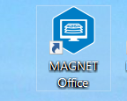
MAGNET Office – Product Activation
Firstly you must be connected to the Internet for Online Activation.
Please click your Magnet Office desktop icon to launch.

Slide 3
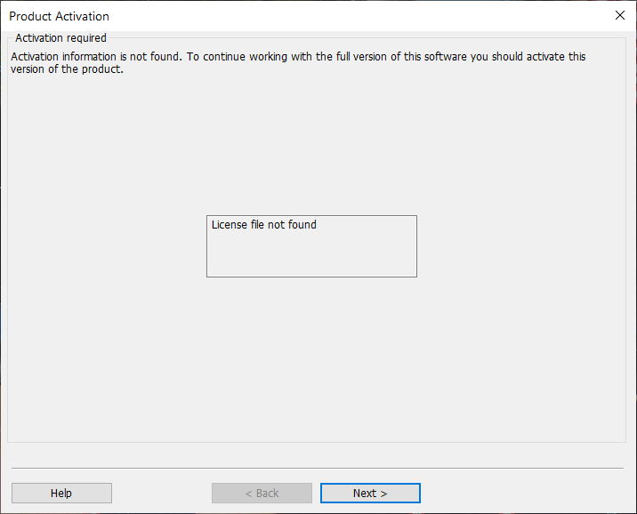
MAGNET Office – Product Activation
No License is found on the Computer.
Click Next > to Continue

Slide 4
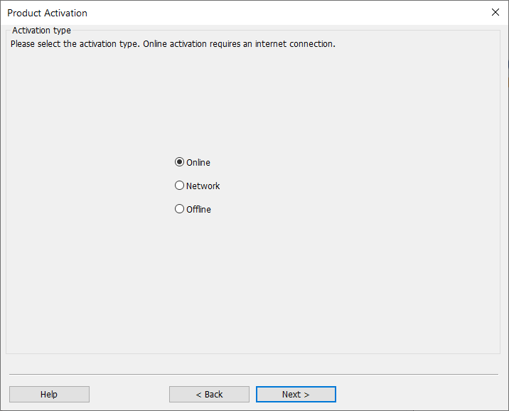
MAGNET Office - Product Activation
Please select Online and click Next > to continue.

Slide 5
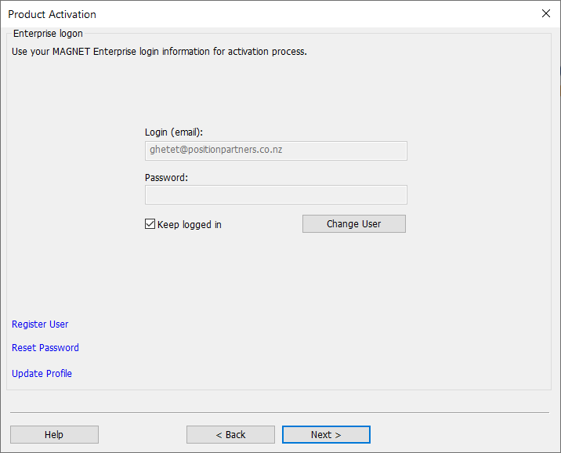
MAGNET Office - Product Activation
Enter your Enterprise login details.
Tick Keep Logged In to avoid having to re-enter login details.
Select Next > to continue

Slide 6
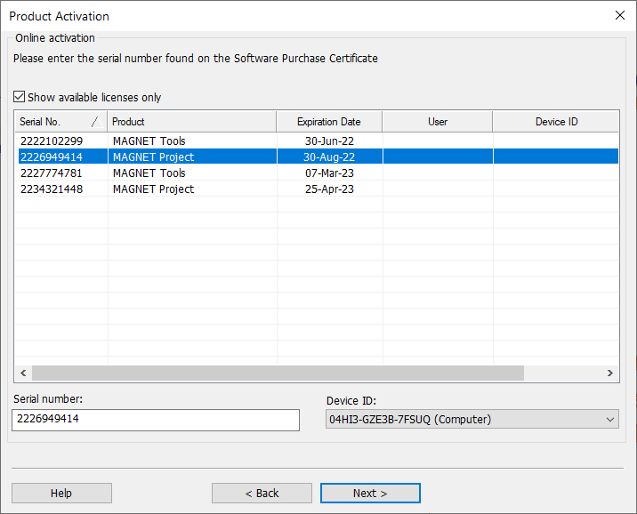
MAGNET Office - Product Activation
Enter the Serial number provided on the Purchase Certificate.
Select Computer for the Device ID and click Next to continue or can be activated to a USB key enabling the license to be used on other PC’s, select the appropriate Device to activate to.
Click Next > to continue

Slide 7
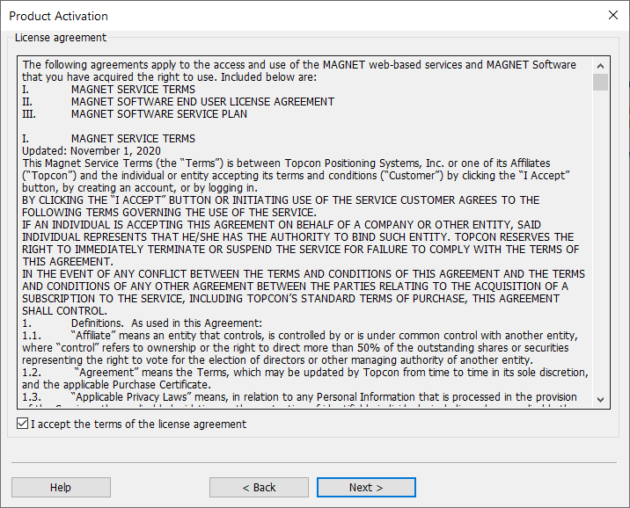
MAGNET Office - Product Activation
License Agreement displays.
Tick - I accept the terms of the license agreement.
Select Next > to continue.

Slide 8
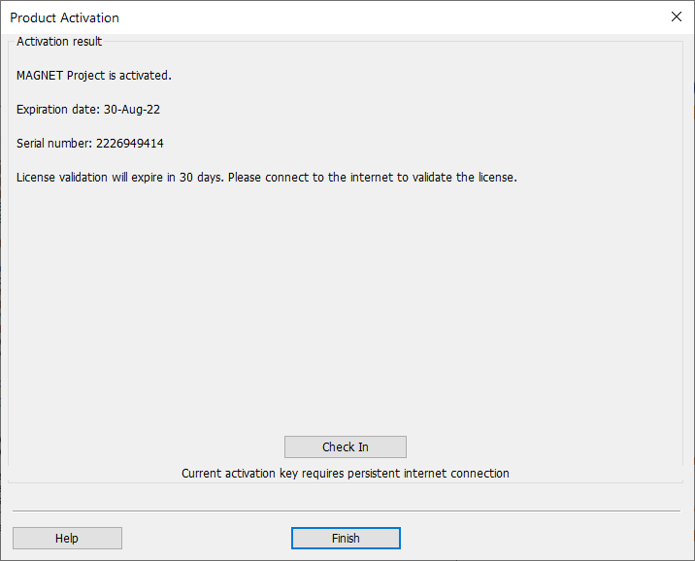
MAGNET Office - Product Activation
Product is now activated.
Click Finish and open Magnet Office.

