Slide 1
Check In - Check Out
Procedure for Setting up Check In Check Out
Graeme Hetet
Customer Success Manager - Magnet
Notes:
Tip: to change the profile image, click on it once, go to ‘picture format’ and select ‘change picture’.

Slide 2
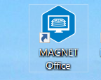
MAGNET Office – Product Activation
IMPORTANT NOTE: The Magnet Office License (perpetual or subscription) must be current for Check In / Check Out. For Licenses that have expired perpetual licenses, you can use Traditional method to activate. To renew your subscription or service plan, please contact your local Position Partners branch for renewal.
Firstly you must be connected to the Internet for Online Activation.
Please click your Magnet Office desktop icon to launch.

Slide 3
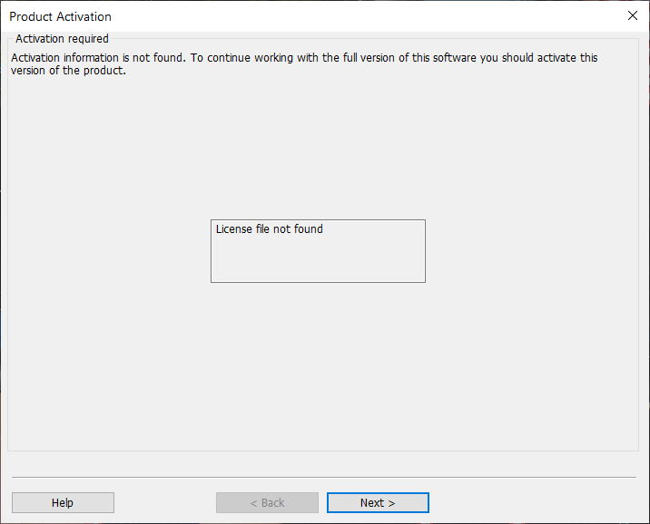
MAGNET Office – Product Activation
No License is found on the Computer.
Click Next to Continue

Slide 4
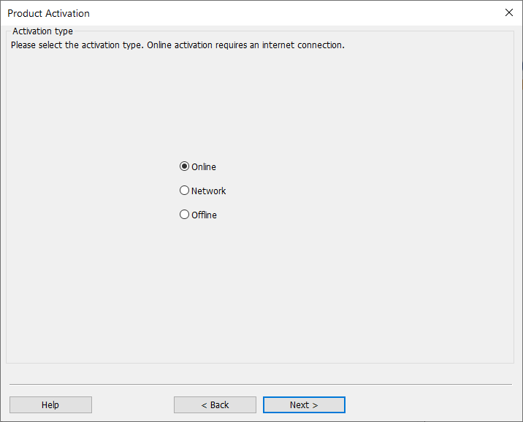
MAGNET Office - Product Activation
Computer must have Internet Connection.
Please select Online and click Next.

Slide 5
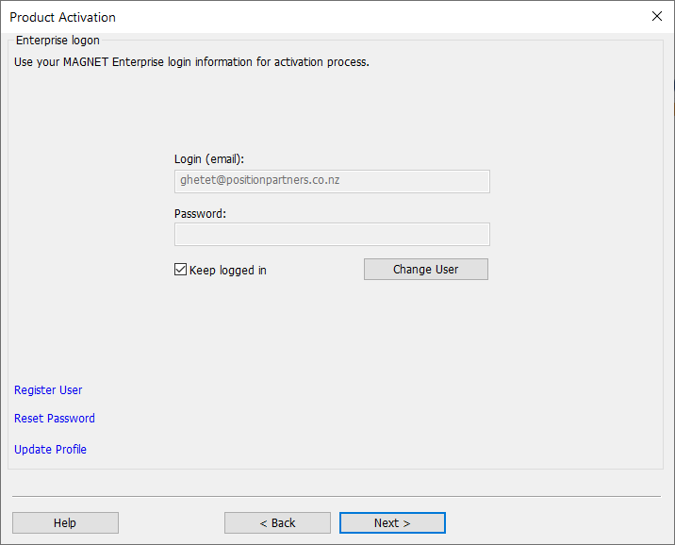
MAGNET Office - Product Activation
Enter your Enterprise login details.
Tick Keep Logged In to avoid having to enter Enterprise credentials when using Check In/Out.
Select Next to continue.

Slide 6
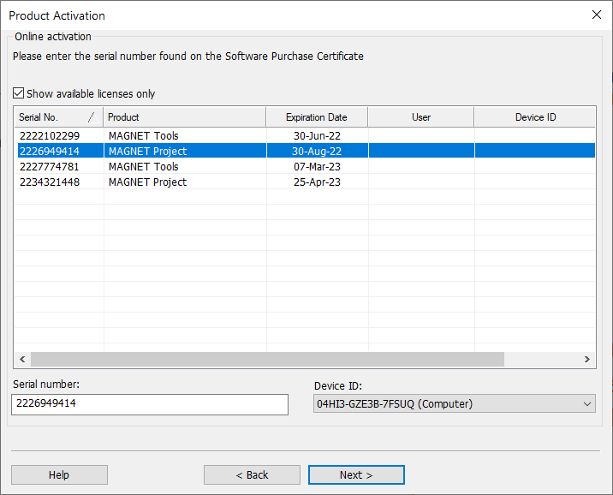
MAGNET Office - Product Activation
Tick Show available licenses only.
Select the Product for the license or enter the Serial number provided on the Purchase Certificate.
Note: User and Device ID fields must be blank.
Select Computer for the Device ID and click Next to continue

Slide 7
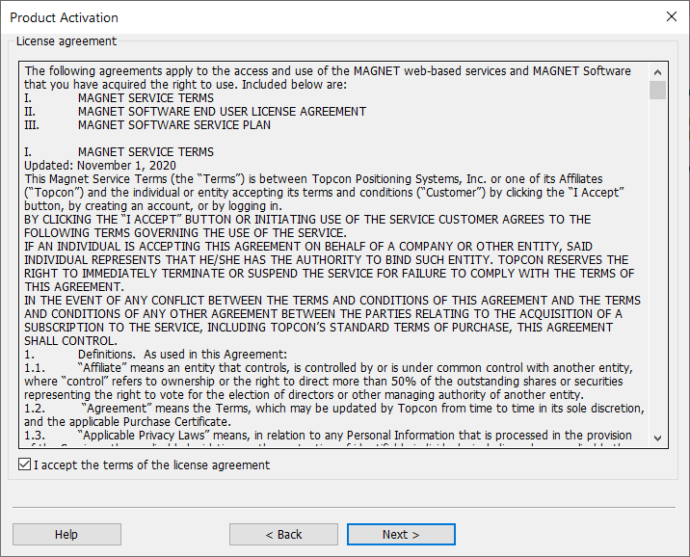
MAGNET Office - Product Activation
License Agreement displays.
Tick - I accept the terms of the license agreement.
Select Next to continue.

Slide 8
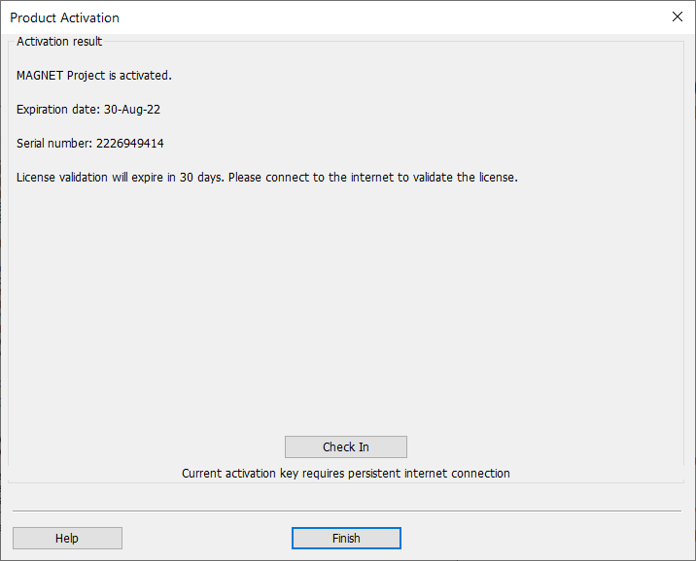
MAGNET Office - Product Activation
Product is now activated.
Click Finish and open Magnet Office.

Slide 9
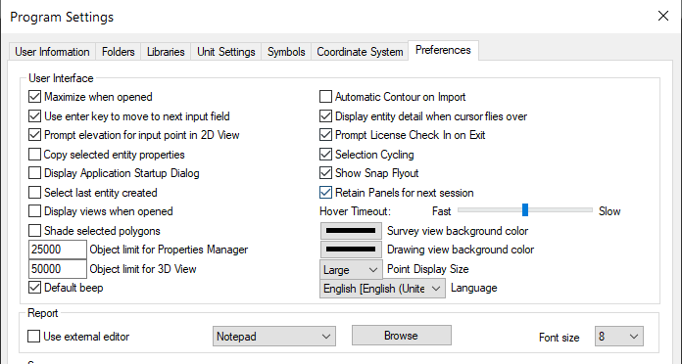
MAGNET Office - Program Settings
Select Program Settings > Preferences tab.
Tick – Prompt License Check In on Exit and select OK

Slide 10
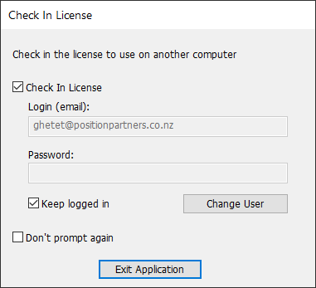
MAGNET Office – Check In License
Upon Exiting Magnet Office, the Check In License screen displays. The Check In License tick is preset from Program Preferences. Keep Logged In is set therefore not requiring re-entry of login details.
Click EXIT APPLICATION to release the license.
When re-entering Magnet Office you will need to manually select an available free license.

Slide 11
MAGNET Office License
License is now free to activate on another computer.

Slide 12
MAGNET Office – Check In License
Ticking “Don’t Prompt Again” will clear the “Prompt License Check In on Exit” and will Check the License in.
Re-entering Magnet Office will attempt to use the same license serial number to enter the program.
If the license is unavailable, checked out by another user or has an expired license or service plan, the Product Activation dialog will display listing of available licenses. Select another license and continue.

Slide 13
MAGNET Office – Traditional
If Check In License is unticked, then Magnet Office operates as a standalone license and the license is held by the Computer. No Check In dialog is displayed.
Click EXIT APPLICATION to close Magnet Office.
Upon re-launching Magnet Office, the program will open with the same license.

